Slide 1

King County’s best historic houses
DS
Inc.
To sellers
(and buyers)

Slide 2
Who am I
Ron Silva
Geographer and Data Analyst
Client
The seller Zachary Brooks

Slide 3

Goal
Finding the best historic houses for the investor who wants them in the best neighborhoods of King County, and to resell them within a year with high profits. He is willing to renovate the house.

Slide 4
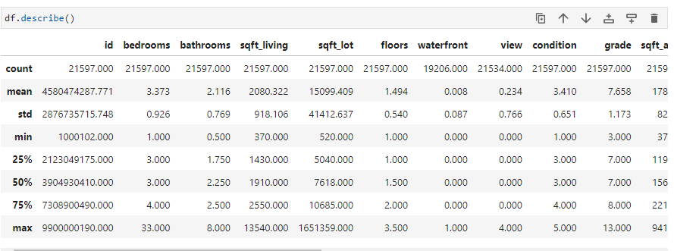
Data what I am working on
A database that contains information about home sales in King County (USA)
Contains 21597 records and 23 variables with informations as bathrooms, bedrooms, living and lots sqft, conditions of the construction/house, if it was renovated or not (and when), year of build, zip code, price, etc

Slide 5
Data what I am working on - Labels
BUILDING GRADE
Represents the construction quality of improvements. Grades run from grade 1 to 13. Generally defined as:
1-3 Falls short of minimum building standards. Normally cabin or inferior structure.
4 Generally older, low quality construction. Does not meet code.
5 Low construction costs and workmanship. Small, simple design.
6 Lowest grade currently meeting building code. Low quality materials and simple designs.
7 Average grade of construction and design. Commonly seen in plats and older sub-divisions.
8 Just above average in construction and design. Usually better materials in both the exterior and interior finish work.
9 Better architectural design with extra interior and exterior design and quality.
10 Homes of this quality generally have high quality features. Finish work is better and more design quality is seen in the floor plans. Generally have a larger square footage.
11 Custom design and higher quality finish work with added amenities of solid woods, bathroom fixtures and more luxurious options.
12 Custom design and excellent builders. All materials are of the highest quality and all conveniences are present.
13 Generally custom designed and built. Mansion level. Large amount of highest quality cabinet work, wood trim, marble, entry ways etc.

Slide 6
Data what I am working on - Labels
BUILDING CONDITION
Relative to age and grade. Coded 1-5.
1 = Poor- Worn out. Repair and overhaul needed on painted surfaces, roofing, plumbing, heating and numerous functional inadequacies. Excessive deferred maintenance and abuse, limited value-in-use, approaching abandonment or major reconstruction; reuse or change in occupancy is imminent. Effective age is near the end of the scale regardless of the actual chronological age.
2 = Fair- Badly worn. Much repair needed. Many items need refinishing or overhauling, deferred maintenance obvious, inadequate building utility and systems all shortening the life expectancy and increasing the effective age.
3 = Average- Some evidence of deferred maintenance and normal obsolescence with age in that a few minor repairs are needed, along with some refinishing. All major components still functional and contributing toward an extended life expectancy. Effective age and utility is standard for like properties of its class and usage.
4 = Good- No obvious maintenance required but neither is everything new. Appearance and utility are above the standard and the overall effective age will be lower than the typical property.
5= Very Good- All items well maintained, many having been overhauled and repaired as they have shown signs of wear, increasing the life expectancy and lowering the effective age with little deterioration or obsolescence evident with a high degree of utility.

Slide 7
Hypothesis
How many historic houses (over 100 years old) are there in King County?
What is their profile when it comes to the possibility of renovation? Which ones are worth it?
How to define a good neighborhood for a investor?
Is it possible to find houses in this profile that are worth investing in for later sale?

Slide 8
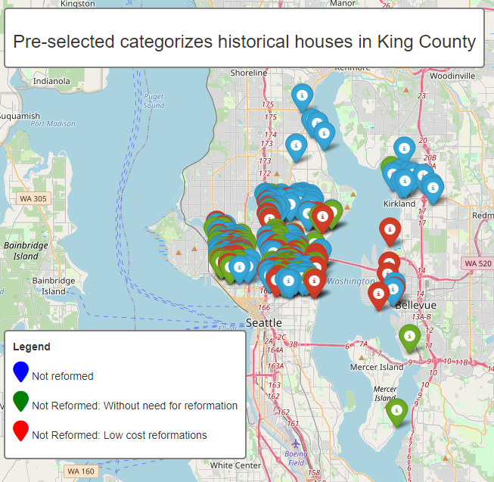
Results of the hypothesis 1, 2 and 3
Historic houses profile | Count
Not Reformed*: Low cost reformations | 198
Not Reformed*: Without need for reformation | 235
Not reformed* | 1.370
Total | 1.803
* Not reformed in the last 10 years

Slide 9
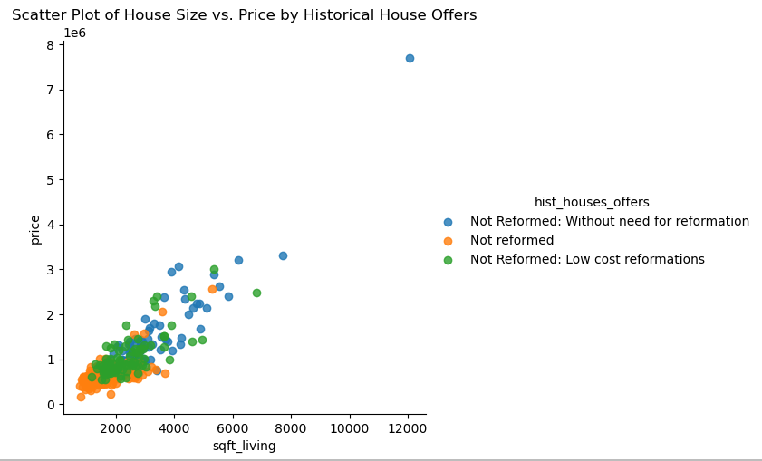
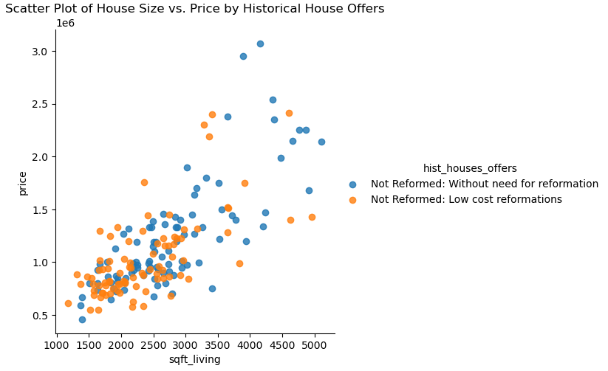
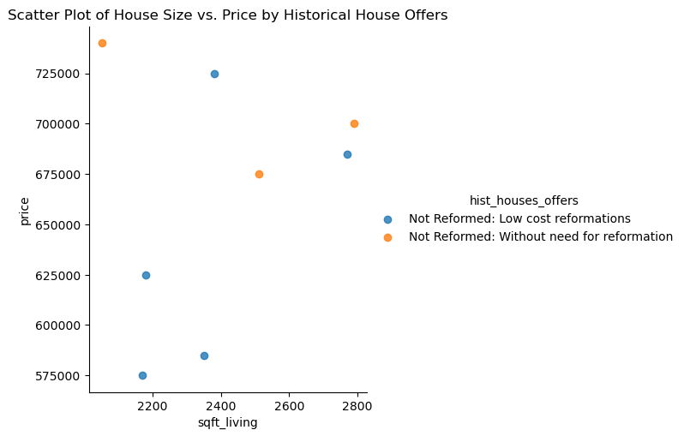
Results of the hypothesis 4

Slide 10
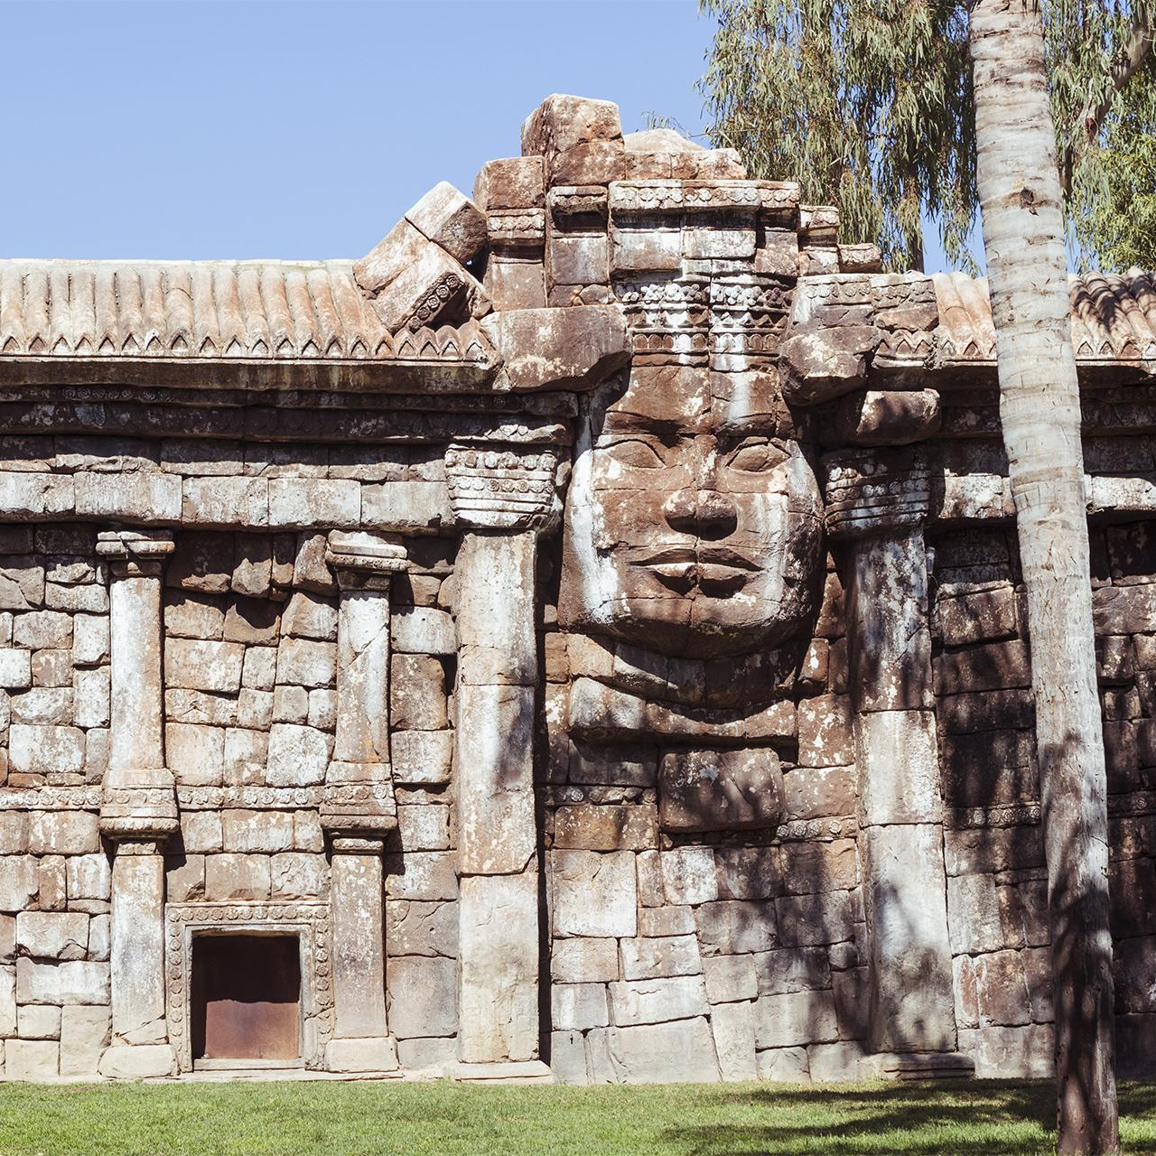
Insights and recommendations
8 historic hauses
5 with low cost reformations
3 Without need for reformation!

Slide 11
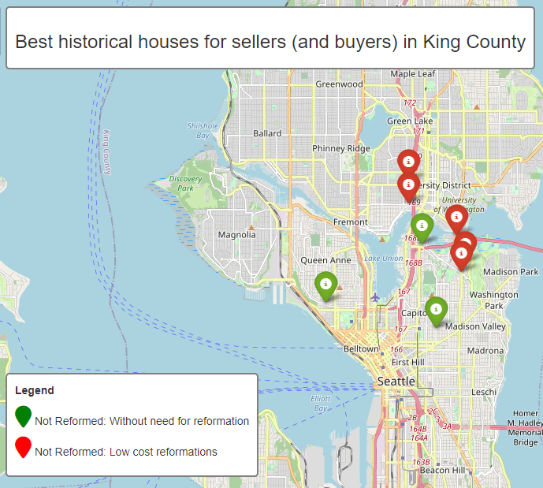
Insights and recommendations

Slide 12
Insights and recommendations
Type of the historic hauses | Price | Bedrooms | Bathrooms | Sqft_living | Sqft_lot | Floors | Built year | zipcode | lat | long | id
Not Reformed: Low cost reformations | USD 575.000 | 3 | 2 | 2168 | 4000 | 1.5 | 1907 | 98105 | 476.561 | -122.325 | 4206901155
Not Reformed: Low cost reformations | USD 585.000 | 5 | 3 | 2350 | 4178 | 1.5 | 1922 | 98112 | 476.388 | -122.3 | 8712100320
Not Reformed: Low cost reformations | USD 625.000 | 4 | 2 | 2180 | 4431 | 1.5 | 1912 | 98112 | 47.636 | -122.302 | 8722101370
Not Reformed: Low cost reformations | USD 685.000 | 6 | 2 | 2770 | 5854 | 1.5 | 1921 | 98112 | 476.466 | -122.304 | 5605000595
Not Reformed: Low cost reformations | USD 725.000 | 6 | 2 | 2380 | 4080 | 2.0 | 1917 | 98105 | 476.629 | -122.325 | 1890000225
Not Reformed: Without need for reformation | USD 675.000 | 3 | 2 | 2510 | 3600 | 2.5 | 1907 | 98112 | 476.195 | -122.313 | 6003001760
Not Reformed: Without need for reformation | USD 700.000 | 6 | 3 | 2790 | 4550 | 2.5 | 1907 | 98119 | 47.627 | -122.361 | 3880900245
Not Reformed: Without need for reformation | USD 740.000 | 4 | 2 | 2050 | 4400 | 1.5 | 1922 | 98102 | 47.644 | -122.319 | 1959700550

Slide 13
Average cost to remodel a 2500sqft house in Seattle
- Kitchen remodel: $20,000 to $50,000
- Bathroom remodel: $10,000 to $25,000
- Interior painting: $5,000 to $10,000
- Flooring remodel: $5,000 to $10,000
- Electrical and plumbing system upgrades: $10,000 to $20,000
- Total average cost: US$ 100.000 *
* For houses in a worse average state of repair than those selected in this study
Source: https://www.homebuilderdigest.com/

Slide 14
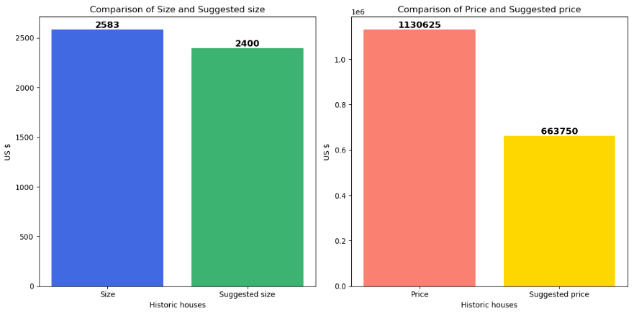
Insights and recommendations

Slide 15

Thanks!
ronniealdrin@yahoo.com https://github.com/ronniealdrin
CREDIT: This presentation template was created by Slidesgo, including icons by Flaticon, and infographs and images by Freepic
Please keep this slide for attribution

Slide 16
Thanks!
ronniealdrin@yahoo.com
https://github.com/ronniealdrin
Please keep this slide for attribution

